Slide 1
GE Renewable Energy
Supplier Handbook

Slide 2
1
DISCLAIMER
The information in this handbook is provided for convenience of our suppliers and may be subjected to change from time to time without prior intimation. This document may be used as a guide but not as a substitute to GE Renewable Energy Global Supply Chain Procedures, Work Instructions or Quality Management System.

Slide 3
GE Renewable Energy
2
Integrity
GE considers the professional behavior of its people and its interfaces in all business relations to be of paramount importance. Improper behavior in business has the potential to jeopardize the image of GE’s employees, suppliers, customers, clients and other partners.
Building Success
GE Renewable Energy is committed to customer success. Key to achieving that success is the application of consistent, effective processes for designing and manufacturing products and delivering services. These processes extend beyond GE Renewable Energy to include our entire supply chain.
This handbook is intended to explain how each of the key processes involving suppliers works. In the pages that follow, each of these processes is explained in further detail. Please take the time to review these processes. They will be key to your company’s effective involvement in the GE Renewable Energy supply chain.
If you have any questions, contact your GE Commercial Leader or your GE Supplier Quality Engineer. Thank you for your contributions to our mission of furthering our customers’ success.
MNDA /
Supplier Integrity
RFQ
Supplier Evaluation/ On-board
FPQ / NPI
Deviation Process
Shipping Process
NC
Material Process
Corrective Action Process
e
eCAV/SPC Monitoring
Supplier Surveillance Audit
RFQ

Slide 4
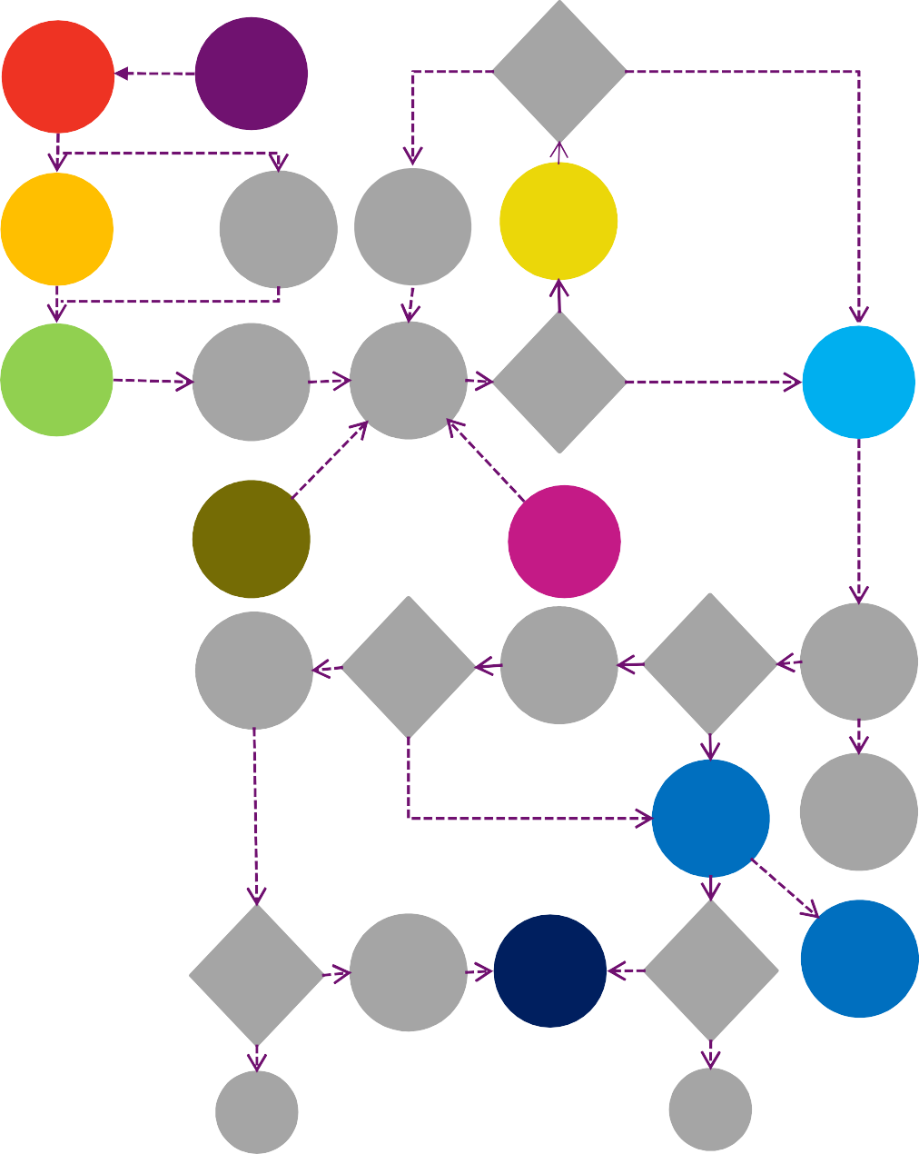
Our Integrated Supply Chain Processes
The first step we take with any prospective supplier is to obtain a signed Mutual Non-Disclosure Agreement (MNDA) between GE and the supplier. Once the MNDA and Supplier Integrity Commitment are
3
RFQ
MNDA /
Supplier Integrity
N
GE
Accepts
Y
?
on file, we can send the supplier a Request For Quote (RFQ).
Deviation?
Having identified a candidate company, we take steps to assess the supplier’s capabilities, according to our formalized Supplier Evaluation & On-boarding Process.
Supplier Evaluation &
On-board
Discuss Details
Execute disposition
Supplier Deviation Process
Once we have determined the appropriateness of forming a commercial relationship with the supplier, we can initiate our First Piece Qualification (FPQ) / New Product Introduction (NPI) process, which helps ensure that the products made by that supplier will be right the first time and every time.
SRG
White Paper
3. Commodity Assessment
N
FPQ / NPI
Scheduling Process
Supplier Production
Material Is Compliant / Acceptable?
Y
Ship Product/ Material
If at any point prior to shipment the supplier identifies a non- conformant condition that it believes may still be acceptable, the supplier can request permission to ship the product, despite its condition, through our Supplier Deviation Process.
Supplier Surveillance Audit
eCAV / SPC
Monitoring
Once ready, products are transported to our facility in compliance with the requirements of our Shipping Process, which includes requirements related to packaging, bar coding and other activities.
If a non-conformance is found after a product has been shipped, a Non-conformance Material Report will be written against it as part our Non-conformance Material Process. In cases in which a supplier’s defects have significantly adverse consequences, the Supplier Recovery Process may be employed.
Ship to Customer
Y
Material Is Compliant & Acceptable?
GE
Production
Y
Material Is Compliant & Acceptable?
GE receives Product/ material
N
N
If the non-conformances are severe or chronic, the issue may be more formally addressed with our Corrective Action Process.
NC
Material Process
Supplier payment
Throughout the relationship, our eCAV Monitoring / SPC Process (as applicable, specific to products) helps suppliers continually strive for improvements that achieve higher levels of customer success.
Are there Reliability Problem?
Y Warranty process
Corrective Action Process
Y
Is defect Chronic or Severe?
Supplier Recovery process
The Supplier Surveillance Audit Process likewise ensures a continued focus on quality improvement to support customer success.
N
N
End
End

Slide 5

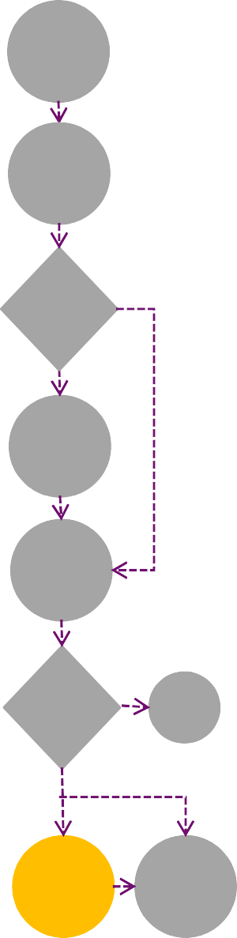


RFQ Process
Supplier On-boarding Process
4
MNDA & SIC
The identification of potential suppliers may involve approved suppliers as well as those new to GE Renewable Energy.
The Supplier Evaluation Process begins with identification of a prospective supplier. A commercial Leader take this step.
Supplier Evaluation
Engineering releases drawing
Supplier Identified
Identify Potential supplier
Before proceeding, GE will ensure that a Mutual Non-Disclosure Agreement (MNDA) & Supplier Integrity Commitment (SIC) with the supplier is on file. To be current, the MNDA/SIC must have been signed within the previous five years. The MNDA/SIC is a document required for any type of collaboration between GE and its suppliers. The document binds both parties not to divulge technical information or any other type of proprietary information to third parties without prior written consent of the other party.
N
Will Product(s) be Critical or Costly?
In cases in which the product to be supplied is costly or especially critical to the proper functioning of GE’s product, greater scrutiny is applied to the supplier evaluation process.
Is a current MNDA on file?
Y
Survey link sent to supplier
N
REACH & Compliance Survey
Complete and sign MNDA
Once MNDA/SIC is signed by supplier, the drawing can be sent out for quote.
Supplier Submits answers
RFQ
GE personnel then visit the site where the
Appr l
supplier’s product(s) are to be manufactured. The evaluation examines a
Approval
If the quote is found to be acceptable technically & commercially in line with general details such as shipping logistics, agreement to terms and conditions, etc., the process can proceed to clarification of finer purchasing details including initiation of supplier evaluation and on- boarding.
Are answers Acceptable?
N
variety of aspects of the supplier’s operation. These aspects are listed in greater detail in the following page.
Request and receive quote
Y
On-site evaluation
If the supplier has provided acceptable responses to all areas of questioning and the total score of the evaluation is at or above the minimum acceptable level, the supplier can be approved through eSA (electronic Supplier Approval Process).. If not, shortcomings can be addressed and the supplier may be reappraised. Once found to be acceptable, the supplier may then be approved.
Is quote Acceptable?
N
End
Suppliers of products that involve considerable expense and those that are especially critical to the proper functioning of GE’s product will be
Y
evaluated in greater depth approved as a supplier. Assessment is typically done.
prior to being
Are supplier’s capabilities acceptable?
N
A commodity
Supplier Evaluation (if req’d)
Discuss Details
Y
Complete eSA.. activate In SMF
Reject Supplier
ej pp

Slide 6

For a company to become an approved supplier to GE Renewable Energy, it must :
5
Comply with ALL applicable laws (including those dealing with labor & environmental practices (EHS) ; Technical Regulations & Standards (TRS)
Maintain no relationship with any country embargoed or blacklisted by the United States.
Have procedures to ensure the protection of its intellectual property and that of its customers.
Have procedures to safeguard against the improper export of controlled technical data.
Compliance
Have a long-range business plan (i.e., covering three years or more).
Have a history of good labor relations.
Understand and measure total cost.
Management
Have a formal order-to-delivery planning system; Ship on time to commitments more than 95% of the time.
Generally try to accommodate schedule changes.
Have documented cycle times based on actual data.
Respond to customer feedback with generally acceptable answers.
Responsiveness
Be able to assure acceptability of incoming products and services.
Have a reliable gage calibration and maintenance program.
Control internal non-conforming material, including finding its root cause & maintain effective Corrective Action System
Have employees who are well trained for their respective jobs.
Maintain on effective system of inspection, testing and internal auditing.
Maintain effective systems of process control and document control & maintain effective traceability system
Quality
Manufacturing Technology
Use manufacturing instructions and process routing sheets.
Control revisions to manufacturing documents through a central person or organization.
Make revisions accessible to manufacturing personnel.
Develop manufacturing processes for activities such as sample production and prototype evaluation.
Have software necessary to perform design analysis (CAD, FEA etc.).
Maintain a design review & TRS Compliance process.
Have a control procedure for engineering documents.
Employ personnel with appropriate qualification & adequate work experience in key roles.
Engineering Technology
Special Processes & NDT
Exhibit good control of ‘special processes’ (those for which compliance cannot easily be verified by examining the final product), including but not limited to : casting, forging, heat treating, welding, wire crimping and printed circuit board manufacturing
Ensure Non-Destructive Test (NDT) procedures are established and qualified (as applicable) - including Visual Testing (VT), Ultrasonic Testing (UT), Magnetic Particle Testing (MPT), Liquid Penetrant Testing (LPT), Radiographic Testing (RT)( etc..

Slide 7
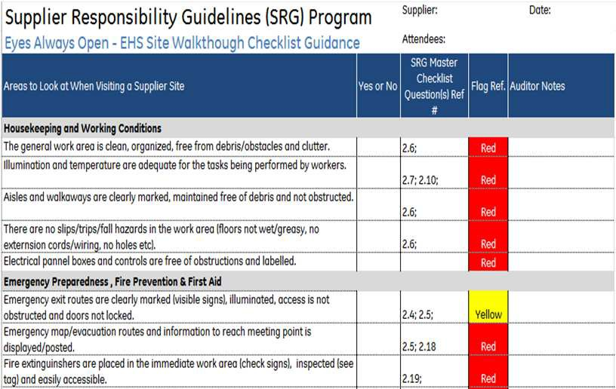

6
Supplier Responsibility Guideline (SRG)
Expectations from Suppliers:
Compliance with laws and regulations protecting the environment
Provision of a safe and healthy workplace
No workers below the legal minimum age or 16, whichever is higher
No forced, prison, or indentured workers or workers subject to any form of coercion
Compliance with minimum wage, hour of service and overtime wage laws
Freedom of association
No discrimination at work in any form
No harassment of employees
Key Steps:
EHS Pre-visit Template
On-Site Audit
Identify Issues If any
Closure of findings
EHS approval In Gensuite
NOTE : EHS approval in Gensuite is a pre-requisite for vendor on-boarding. Periodicity of re-audit is based on supplier risk assessment followed by GE Renewable Energy, time to time.
7
GE Supplier Responsibility Program
2010 Version

Slide 8


New Product Introduction / First Piece Qualification Process Flow
7
Project Scoping
The first step in the New Product Introduction Process or First Piece Qualification- Project Scoping, is undertaken by GE internally. It involves an assessment of whether or not the pursuit of an NPI/FPQ for a particular component is warranted. This decision considers such factors as resources required to pursue the project and the benefits it would provide.
NPI / FPQ
NPI/FPQ
This step is also undertaken internally by GE. The objective is to define the requirements of the component in question, verifying that all critical characteristics have been identified and all specifications have been correctly documented.
Product Definition
This step is also undertaken internally by GE. The objective is to detail the activities the supplier must perform in order to validate the component to be supplied. Validation requirements may include (but are not limited to) such activities as First Piece Inspection, material certifications, functional testing and reliability testing. Supplier Quality Requirements are covered under document P28-A-AL-0002 (will be shared with supplier in ITO (Inquiry to Order) Phase.
Define Qualification Req’ts
Product Qualification
This is the first step in the NPI process that is completed by the supplier. The series of activities defined in the Product Validation Plan are intended not only to validate that the product has been made correctly, but that the processes used to make that product are well-controlled and sustainable. The activities in this step must be completed and their results supplied to GE for approval. These activities are described in further detail in following pages.
Validate Product
This step involves an assessment by GE of the validation information provided by the supplier to ensure its acceptability. If the information is determined to be acceptable and complete, the project will be closed. NOTE: Once suppliers have reached this stage, they should NOT make any changes to manufacturing processes involving GE products without first obtaining written approval from GE Renewable Energy.
Project Closure
Depending on specific criteria, certain products may need to be revalidated at some point after the project was initially closed. This step consists of verifying that documented processes are still being followed, that process capabilities remain acceptable and that control plans continue to be sustained. This is carried out through periodic supplier surveillance and reliability audits.
Revalidate product

Slide 9


NPI/FPQ Process Steps:
This graphic depicts the processes used to manufacture the given product. The more detailed the descriptions of these
Process
8
activities, the more likely any failures can be anticipated and avoided. This document should list all GE reference documents, supplier reference documents, GE material specifications, Equivalent supplier material specifications and list of sub-tier suppliers. Verify by “Walking the Process”
NPI/FPQ
Flow Diagram & MPP
FPQ / NPI
Secure chemical approval
This activity involves verifying that any chemicals accompanying the product when it is shipped to GE Renewable Energy have been approved by GE Renewable Energy and accompanied by MSDS (Material Safety Data Sheet). This includes any Chemicals, paints, coatings or rust preventatives. Terms such as “additives” or “Pigments” are not acceptable.
Process FMEA
With the Process Flow Diagram (PFD) as its basis, this activity considers the various errors that could occur at each process step (the various “failure modes”). The work here involves evaluating the severity of each failure mode’s consequences, the likelihood of its occurrence and its detectability prior to the product’s release. This aids in identifying and mitigating the most troublesome failure modes.
Product Qualification
Develop Process Control Plan
The means of controlling each product characteristic (and any critical process parameters) are to be formally documented in a matrix. The control plan will include details such as specification limits for the characteristic, the means and frequency of checking the characteristic, and the method of ensuring that the characteristic will be kept in control.
Measurement System Validation
The measurement system for any characteristics defined as Critical To Quality (CTQ) must be validated to have an acceptably small amount of error. The goal is to have measurement error of no more than 10% of the associated tolerance. In the case of a characteristic that is discrete in nature, an Attribute Gage R&R score of 90% is the minimum acceptable standard.
Process Capability assessment
The short-term process capability (Z-score) for all characteristics should be at least 4.0 (implying a long-term capability of at least 2.5). In cases of CTQ characteristics, those that exceed this goal may be inspected on a sample basis, and those not reaching the goal must be checked on a 100% basis.
Complete First Piece Inspection
The First Piece Inspection must be approved by a GE Qualification Team (Supplier Quality Engineer, Design Engineer, Material Process Engineer) prior to parts shipment.
The Validation Matrix may include a variety of checks including functional, environmental and reliability testing as well as manufacturability and maintainability considerations.
NOTE : Certain parts may be subject to Post-Validation Requirements (PLQ, Surveillance audits etc.) at some point after initial approval to ensure that process control and process capability are being sustained.

Slide 10


Supplier Deviation Process:
Material and equipments that do not fully conform to GE’s engineering
Supplier
9
Supplier requests deviation
requirements must be approved through Supplier Deviation Request (SDR) Process prior to being shipped. Request for deviation using Clearorbit application.
Deviation Process
Requests deviation
The system sends a notification to the concerned SQE once a deviation request is raised by supplier.
All reqd. Info provided
N
The SQE verifies that all required information has been submitted with the deviation request. If any of this information is missing or unclear, the SQE will obtain clarification before forwarding the request to the appropriate engineer.
Request forwarded to DE
SQE reviews and forward Supplier Deviation Request to concerned Design Engineer (DE) for review and disposition.
DE
Approve Deviation Request?
The responsible engineer makes a disposition of the request as approved or disapproved. If the deviation is disapproved, the supplier will be responsible for replacing the material.
N
Supplier Replaces material
Y
Disposition e-mailed to supplier
Notification of disposition is e-mailed to the supplier as well as the buyer, the Regional (Pole) Supplier Quality Engineer and business SQE.
Attach Deviation Documents to parts
The approved deviation is attached to the packing slip.
Ship Parts to customer
Parts are shipped consistent with the shipping process detailed on the following page of this handbook.

Slide 11

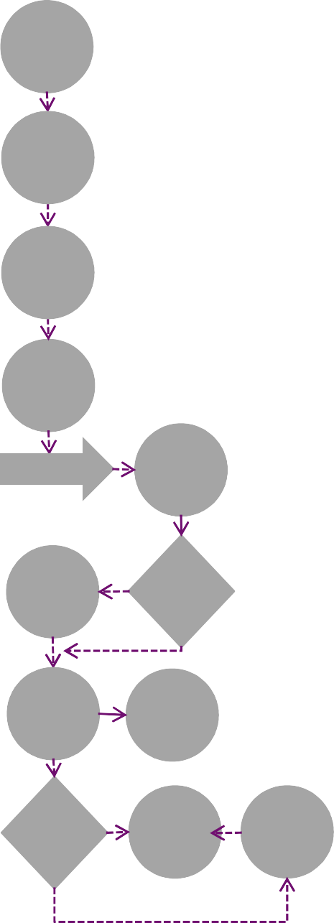
Product Packing, Preservation and Shipping Process
10
Ship Product
Part ready to ship
Requirements for packaging and bar coding are covered by the document P23-AL-0255 which is communicated to vendor as part of RFQ package.
Attach Packing list & bar code label
GE contracts the services of a third-party logistics company to co-ordinate shipments to our facility. Inco-Terms shall be clearly mentioned in supplier quote as well as GE Purchase Order.
Make entry
In ILS / OTM
for pick up
Supplier makes entry in Integrated Logistics System - ILS (which is being replaced by Oracle Transport Management System – OTM (in case shipment in GE’s scope) so that shipping marks are provided and pick up is arranged.
Attach Bill of loading
Ship product
Receiving process
Resolve Y
Problem with buyer
Receiving Problem?
N
Most shipments are received without any problems. If a problem does arise with an order, the GE buyer should be called so that the problem can be resolved.
Issue receiver
Stock Material
In issuing the receiver, GE’s inventory records are updated in the computer system and the material can be stacked to a specific location.
Accounts Y Payable Match?
Supplier payment
Problem resolution
For an order to be paid, a three-way match must be made between the part number, the purchase order number and the price.
N

Slide 12
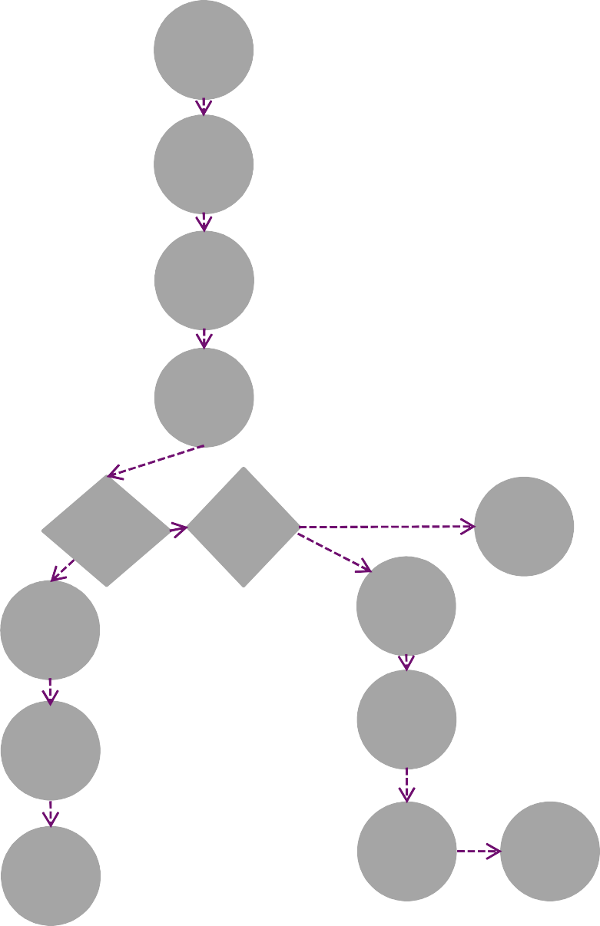



Non Conformance Material & Supplier Recovery Processes
11
NC
Material Process
Identify defective part
A defective part can be identified at any point, including incoming inspection, assembly, integrated testing or during arrival at customer site, thus beginning the Non- conformance Material Process.
NOTE : GE Renewable Energy reserves the right to employ the Supplier Recovery Process in any situation where deficient quality of a supplier’s products has created adverse consequences to GE’s business.
Document defect
Defective material is recorded in a defect tracking system.
Supplier Recovery process
Assessment
GE team verify root cause and supplier
responsibility. The team determines Cost Of
Attach defect tag defective part
If possible, the defective parts should be segregated from the rest of the parts in production to prevent the defective material from being used unintentionally.
Failure / Quality (COF/COQ) and send formal notification to supplier.
Supplier
Review
The team develops and communicates GE’s claims strategy and initiates a negotiation.
pp ev
Disposition
A disposition of repair, rework, use-as-is, scrap or return to vendor is identified, along with the party at fault.
Working with the supplier, the team defines the
S le nt mechanism and process for receipt of compensation.
Part to N
Part to be Scrapped?
N
Rework/ Other disposition
Settlement
be returned
I
Y
To Supplier?
Y
Souring creates shipping notice
Souring gets debit memo
Sourcing obtains a debit memo to
Material may be returned to the supplier if supplier is at fault.
.
nullify payments made for
Financial
Tracking
The flow of funds is tracked, as is verification of compliance with the settlement upon which the parties have agreed.
defective parts.
Debit memo issued
Recording the debit memo on the
Sourcing receives a Returned Material Authorization (RMA).
DMR or equivalent allows
Part shipped
material, in instances in which the
supplier is at fault, to be scrapped.
NOTE : GE Renewable Energy reserves the right to initiate recovery of any losses that occur as the result of defective products or materials shipped by its suppliers. This recovery is not intended as a punitive measure, but rather as a way to hold suppliers accountable for the quality of the products they supply.
Buyer discuss with supplier on recovery process (free replacement or debit note to supplier.
Part dispositioned scrap
Part Scrapped, defect record completed
Complete defect record

Slide 13


12
Corrective Action Process
Issues Identified
Any employee of GE may identify an issue requiring Corrective Action, although an SQE, Manufacturing Quality Engineer or other quality representative most often handles this step.
Corrective Action Process
Iss ident d
Does it merit formal CA ?
N
End
Corrective Actions (CA) are required for any issues involving product safety, infancy failures, chronic or severe quality problems that escape their area of origin, and deficiencies found during audits.
Y
CAR
generated
A Corrective Action Request (CAR) is generated through Clearorbit application. The CAR identifies the nature of the problem as well as when and where it was found. The request also designates who will be responsible for identifying the corrective action to be taken and who will be responsible for approving the plan and its implementation.
Responder Submits proposal
The individual who has been assigned the Corrective Action determines the root cause of the problem, the action to be taken in addressing the root cause and the date by which the action will be taken. If the person assigned is not the appropriate person, the Corrective Action can be reassigned.
Are answers Acceptable?
The person assigned at the time of the CAR’s origination as the Plan approver (Usually also the originator) evaluates the response for its acceptability. If the response is rejected, the Responder must modify and resubmit the proposal.
N
Note that supplier may be required to submit process or product data in order to verify the plausibility of a root cause and the feasibility of corrective action.
Y
Implement Plan/ Update CAR
Once approved, the plan is implemented and the Corrective Action System updated with this information.
N
Y
Once implemented, the Corrective Action is evaluated to determine if it is sustainable and whether or not it is effective. If the evaluation reveals the action is no longer being taken or is
End ineffective, the Corrective Action will be rejected and another CAR will be initiated.
Is CA
effective?

Slide 14

CTQ Monitoring
13
CTQ is Specified on drawing
The characteristic Monitoring Process begins when a characteristic is specified as a CTQ (Critical to Quality) in a drawing. Once the drawing has been completed, the Engineering team releases it to the Supply Chain team.
CTQ
Monitoring
CTQ is Specified on drawing
Supplier Sends data For CTQ
The supplier then makes the parts, takes measurements of the CTQ characteristics and records the measurements. The supplier submits the measurement data to GE. CTQ Process Capability data collection requirements are covered under document P28A-WE-0001 which will be shared during ITO Phase.
Supplier Sends data For CTQ
CTQ reviews with GE will be scheduled by the Supplier Quality Engineer. These reviews will occur on a frequency determined by the SQE.
CTQ Review with GE
Z-Score calculated

Slide 15


Supplier Surveillance
14
Schedule audit
Factors that determine the Supplier surveillance Audit date include the criticality of components supplied, current quality issues, development of new products, significant process changes and corrective action commitments from previous audits.
Supplier Surveillance Audit
Audit notification
The supplier to be audited is notified of the audit’s scope (Product, Process, Quality System etc ) and schedule.
Supplier Information review
Depending on the circumstances of the audit, the supplier may be requested to provide information in advance of the audit to allow the auditors to make the best possible use of everyone’s time.
Opening meeting
The opening meeting confirms such details as the scope of the audit and the logistics that will support effectiveness of the audit.
Conduct audit
While conducting the audit, tours of the supplier’s facilities as well as examination of the supplier’s documentation and records will be required to provide sufficient objective evidence as to the supplier’s compliance with the audited standard.
Closing meeting
Prior to the auditor’s departure, the findings are summarized and the closing meeting is held. The closing meeting presents the strengths and weaknesses discovered during the audit as well as those items requiring corrective action. The timing of any corrective actions should also be discussed at this meeting.
Issue audit report
The audit report ( Supplier Surveillance Report or SSR ) serves as the formal and detailed documentation of those items discussed at the clsoing meeting. Audits are recorded in electronic Supplier Management System (eSMS)
Take CA as needed
The audit report is documented in e-SMS and a system notification is sent to supplier. Upon receipt of closure comments and evidences, SSR is updated by the SQE and a formal notification of closure is sent from system.

Slide 16

In Case of any questions, please reach out to a Commercial Leader or Supplier Quality Engineer in GE Renewable Energy

Slide 17

imagination at work

